Slide 1
Lecture 11: Recurrent Neural Networks
Elad Hoffer
Boris Ginzburg

Slide 2
Agenda
Sequence Classification & Labeling
Introduction to Recurrent NN
Simple RNN
Bidirectional RNN
Vanishing gradient problem
3. Recurrent models
LSTM (Long-Short Term Memory)
GRU (Gated Recurrent Unit)
NTM (Neural Turing Machine)
Links:
Hinton’ course on Deep Learning
Schmidhubber tutorial on LSTM http://people.idsia.ch/~juergen/lstm/
A. Graves, Supervised Sequence Labelling with Recurrent Neural Networks,

Slide 3
Sequence Modeling

Slide 4
Auto-regression
predict the next term in the input sequence.
The target output sequence is the input sequence with an advance of 1 step
It uses methods designed for supervised learning, but it doesn’t require a separate teaching signal
W
X(t-3)
X(t-2)
X(t-1)
X(t)

Slide 5
Sequence Classification & Labeling
The sequence labeling
Handwriting Recognition
Speech Recognition
Part-of-speech tagging
Language translation
Special case of pattern classification:
individual data points cannot be assumed to be independent.
Both the inputs and the labels form strongly correlated sequences. For example a speech signal is produced by the continuous motion of the vocal tract, while the labels (a sequence of words) are constrained by the laws of syntax and grammar.

Slide 6
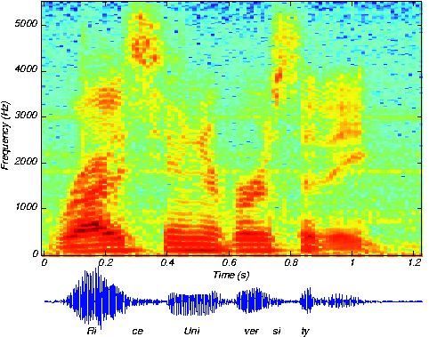
Speech Recognition
X=[x(1),…x(T)] – input vector:
Each x[t] is spectrogram at moment t:
x(t)=[x(t;1),…x(t,N)], x(t,k) is energy in frequency band k.
The goal is to convert X to sequence of symbols:
Y=[y(1),..y(K)], where y(k)={a,.., z, “,” , “.”, blank}
nice university

Slide 7
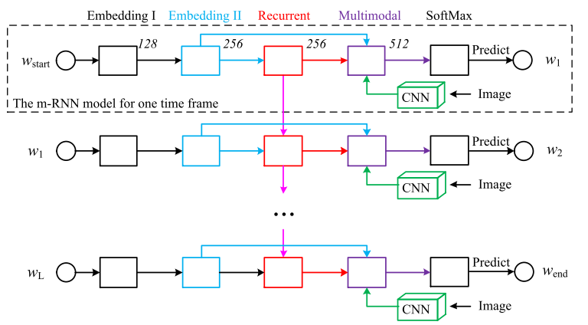
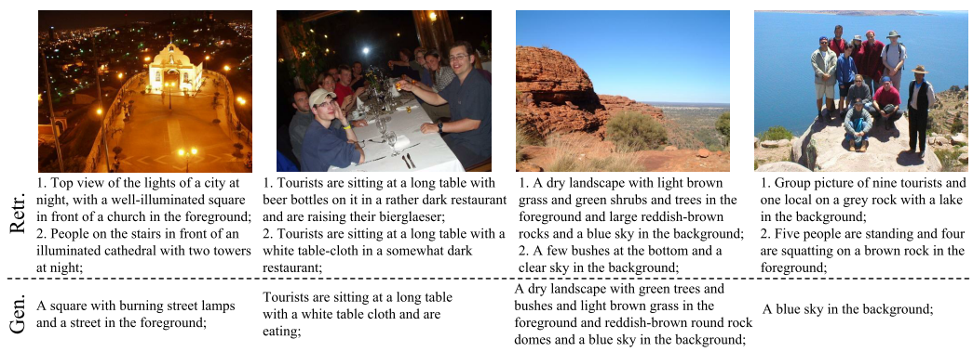
RNN Examples - vision
Deep Captioning with Multimodal Recurrent Neural Networks (Junhua Mao et al 2015)

Slide 8
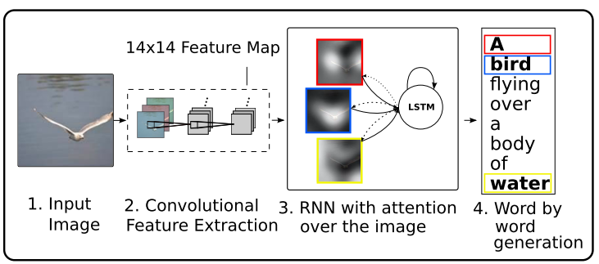
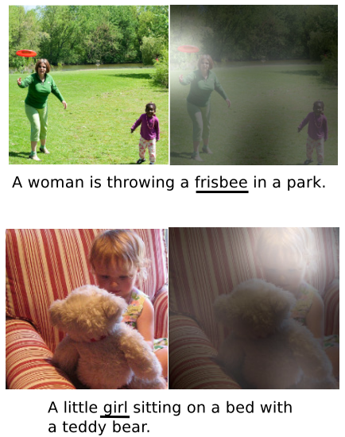
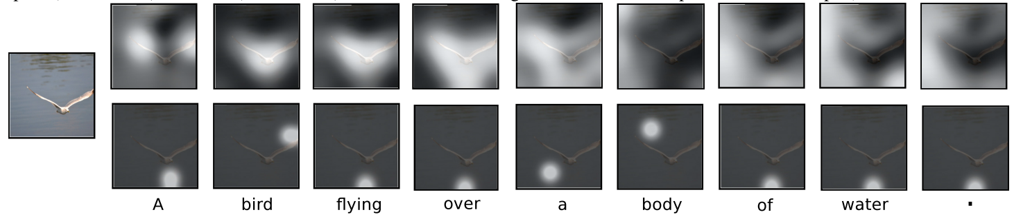
RNN Examples - vision
Show, Attend and Tell: Neural Image Caption Generation with Visual Attention (Kelvin Xu et al, 2015)

Slide 9
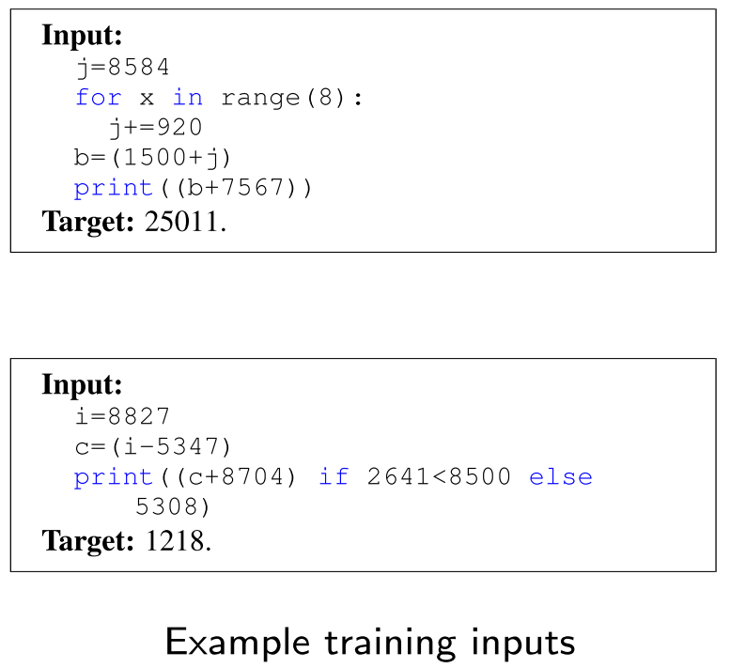
RNN Examples
Learning to execute (Zaremba, Sustkever 2015)

Slide 10
Introduction to Recurrent NN

Slide 11
Approaches to Time Dependent NN
Feedforward architectures (time-delayed neural networks)
Recurrent architectures - represent time recursively
Simple recurrent network (SRN)
Gated Recurrent Architectures (LSTM, GRU)
Explicit memory architectures
Neural Turing machines
Memory networks
Stack RNN

Slide 12
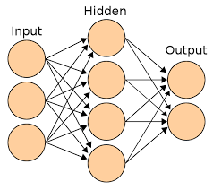
Feed Forward Time-Delay NN
Feed-forward NN (e.g. Conv NN) that represent time explicitly with a fixed-length window of the recent history :
X(t-k)
X(t-2)
X(t-1)
X(t)

Slide 13
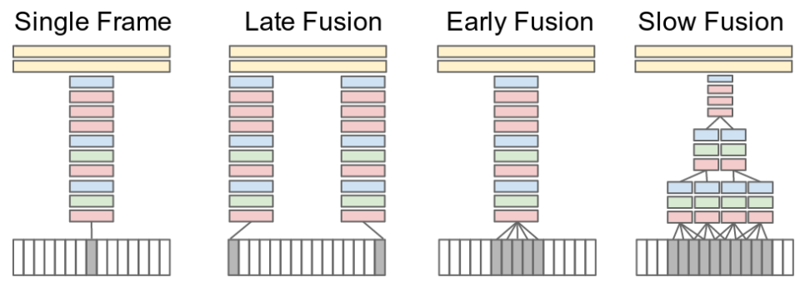
Example - Time-Delay NN
Large-scale Video Classification with Convolutional Neural Networks (Karapthy 2014)
Problems?
Fixing the window size makes long-term dependency harder to learn
Linear increase of the number of parameters

Slide 14
Approaches to Time Dependent NN
Feedforward architectures (time-delayed neural networks)
Recurrent architectures - represent time recursively
Simple recurrent network (SRN)
Gated Recurrent Architectures (LSTM, GRU)
Explicit memory architectures
Neural Turing machines
Memory networks
Stack RNN

Slide 15
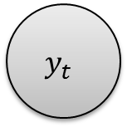
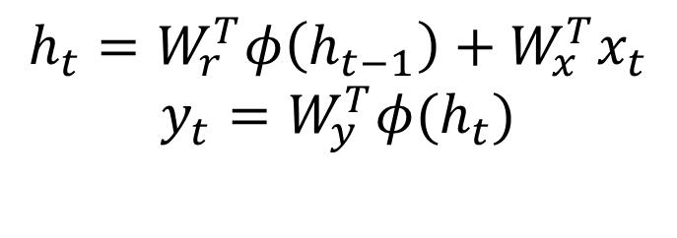
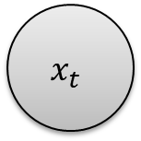
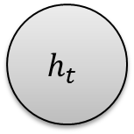
Recurrent NN
Recurrent neural networks (RNNs) is a NNs where connections between units form a directed cycle.
$$y_{t}$$
$$h_{t}=W_{r}^{T}φ\left(h_{t−1}\right)+W_{x}^{T}x_{t}$$
$$y_{t}=W_{y}^{T}φ(h_{t})$$
$$h_{t}$$
$$x_{t}$$

Slide 16
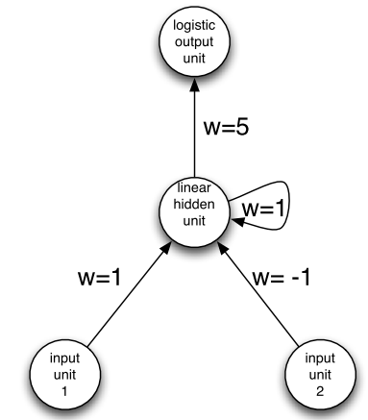
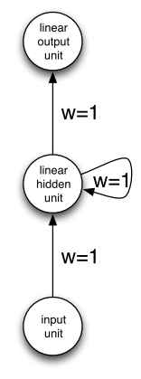
Recurrent NN
RNNs use their hidden states work as memory on previous inputs & states
Temporal dependency & internal memory allow processing of sequences of inputs
Turing complete (Siegelmann &Eduardo)
What theses RNNs do?

Slide 17
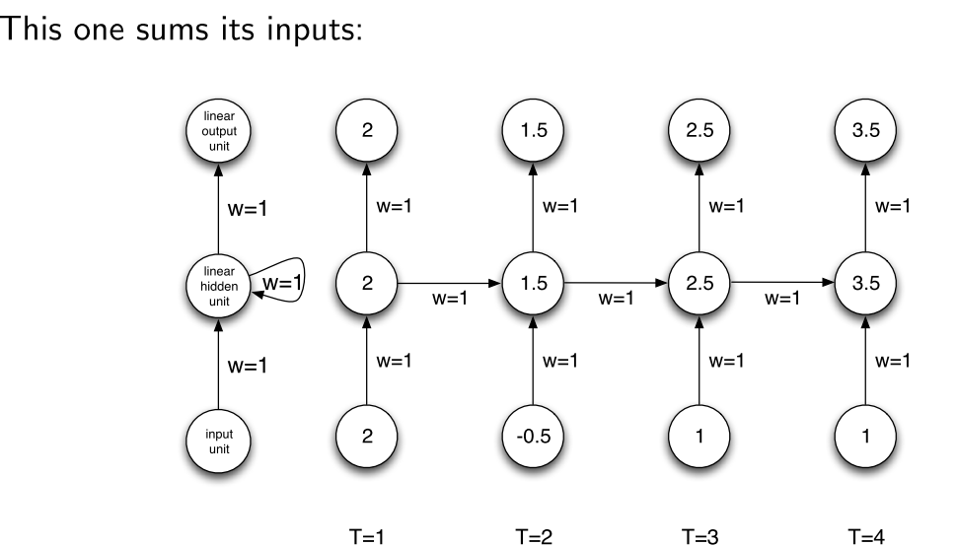
Recurrent NN

Slide 18
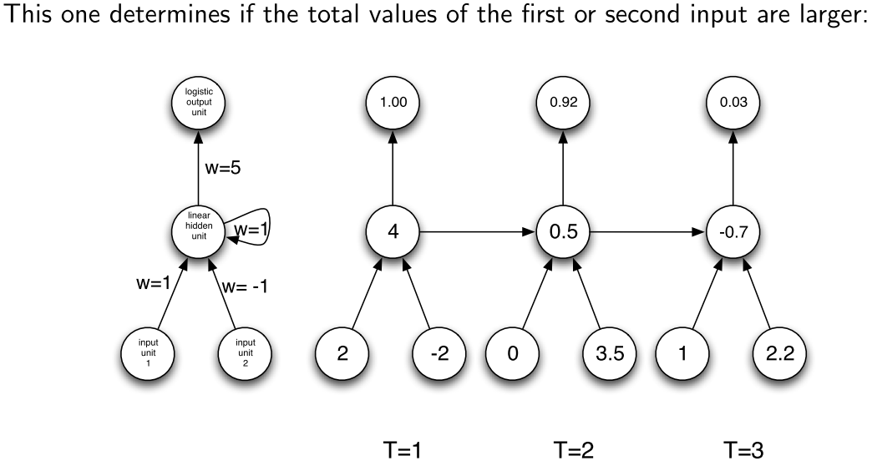
Recurrent NN

Slide 19
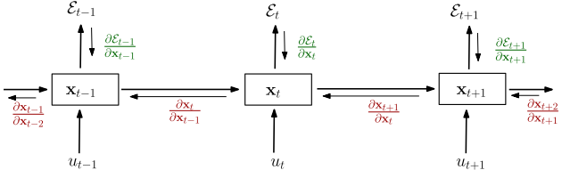
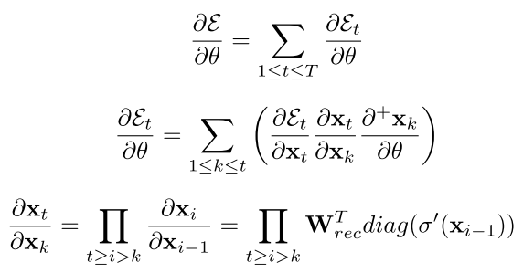
RNN training
Back propagation through time:
Unfold network in time (remember all interm. steps)
Apply gradient back-propagation recursively back in time from T to 1
Sum over the whole sequence ( t=1..T) to get the derivatives with respect to the weights

Slide 20
Bidirectional RNN
For many sequence labelling tasks it is beneficial to have access to future as well as past context.
Most obviously, if the input sequences are spatial and not temporal (protein structure prediction)
temporal tasks, as long as the network outputs are only needed at the end of some input segment (handwriting & speech recognition)
Workaround: fixed n look–ahead window to input.
Bidirectional RNN - more generic idea:
present each training sequence forwards and backwards to two separate recurrent hidden layers, both of which are connected to the same output layer.

Slide 21
RNN: vanishing gradient problem
RNN forward and backward propagation has short memory:
the influence of a given input on the hidden layer, and therefore on the network output, either decays or blows up exponentially
The same with gradient propagation

Slide 22
RNN: vanishing gradient problem
Pascanu et Al, On the diﬃculty of training recurrent neural networks

Slide 23
Approaches to Time Dependent NN
Feedforward architectures (time-delayed neural networks)
Recurrent architectures - represent time recursively
Simple recurrent network (SRN)
Gated Recurrent Architectures (LSTM, GRU)
Explicit memory architectures
Neural Turing machines
Memory networks
Stack RNN

Slide 24
Long Short-Term Memory Networks

Slide 25
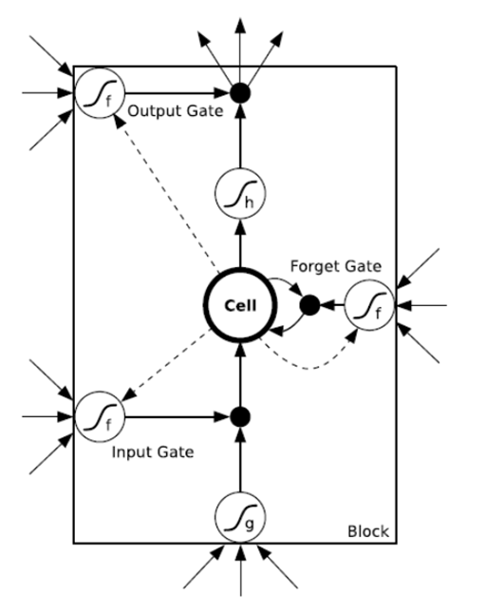
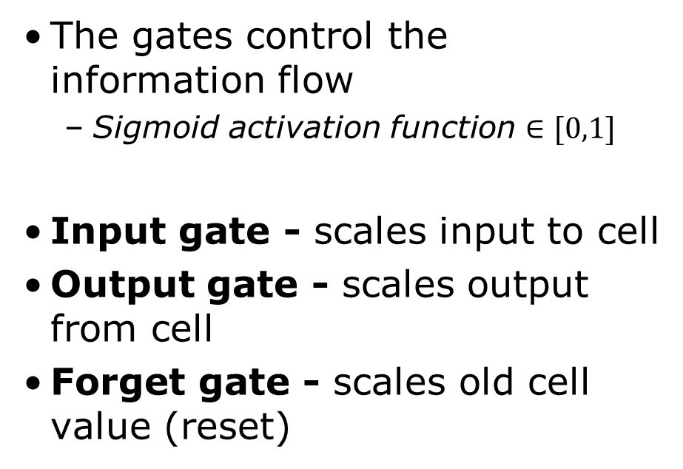
Long Short-Term Memory (LSTM)
Long Short-Term Memory (LSTM) architecture was proposed by Hochreiter and Schmidhuber,1997.
The gates control the information flow
Sigmoid activation function $∈[0,1]$
Input gate - scales input to cell
Output gate - scales output from cell
Forget gate - scales old cell value (reset)

Slide 26
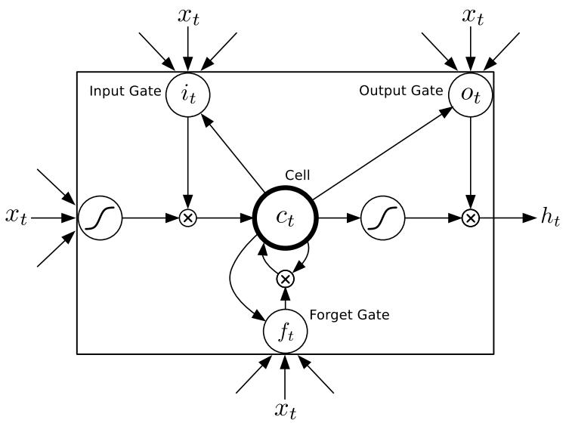
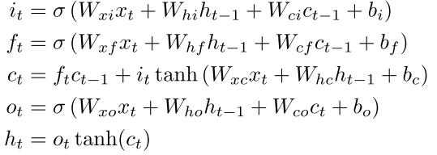
Long Short-Term Memory (LSTM)
Alex Graves, Generating Sequences With Recurrent Neural Networks

Slide 27
LSTM and vanishing gradient
LSTM has LONG memory.
For simplicity, all gates are either entirely open (`O') or closed (`|').
The memory cell `remembers' the first input as long as the forget gate is open and the input gate is closed.

Slide 28
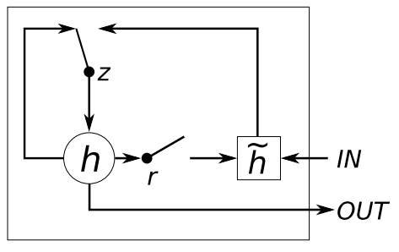


GRU – Gated Recurrent Unit
Chung et al, Empirical Evaluation of Gated Recurrent Neural Networks on Sequence Modeling

Slide 29
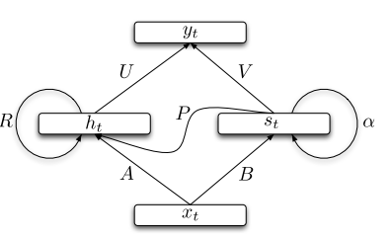


SCRNN – Structurally constrained RNN
Alternative model interpretation:
Mikolov et al, Learning Longer Memory in Recurrent Neural Networks

Slide 30
Approaches to Time Dependent NN
Feedforward architectures - represent time explicitly with a fixed-length window of the recent history (time-delayed neural networks)
Recurrent architectures - represent time recursively
Simple recurrent network (SRN)
Gated Recurrent Architectures (LSTM, GRU)
Explicit memory architectures
Neural Turing machines
Memory networks
Stack RNN

Slide 31
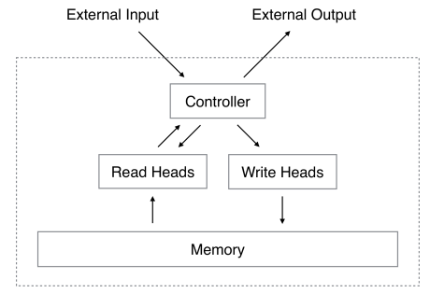


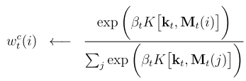
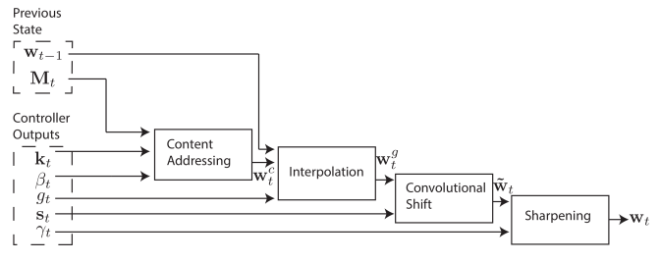
NTM – Neural Turing Machine
Differentiable memory operations
Read:
Erase:
Write:
Focus:

Slide 32
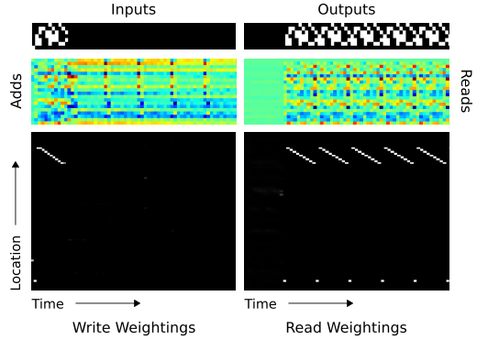
Neural Turing Machine
Repeat copy task
Graves et al, Neural Turing Machine

Slide 33
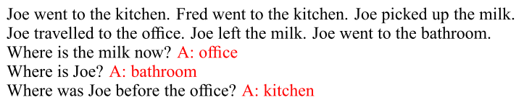
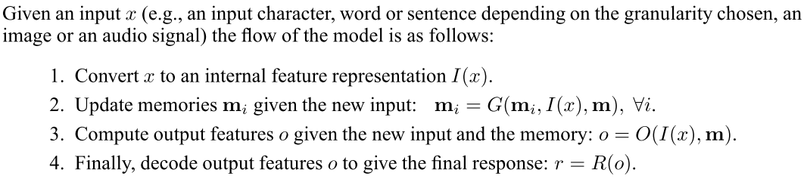
And more…
Memory network (Weston et al 2015) – having explicit memory, answering questions on gathered knowledge.

Slide 34
And more…
Stack-Augmented Recurrent Nets (Joulin, Mikolov 2015) - count and to memorize sequences.

Slide 35
Having fun with LSTM
Train character-level language models based on multi-layer LSTMs
Some fun examples at http://karpathy.github.io/2015/05/21/rnn-effectiveness/
Can we generate Bible chapters that seem reasonable?

Slide 36
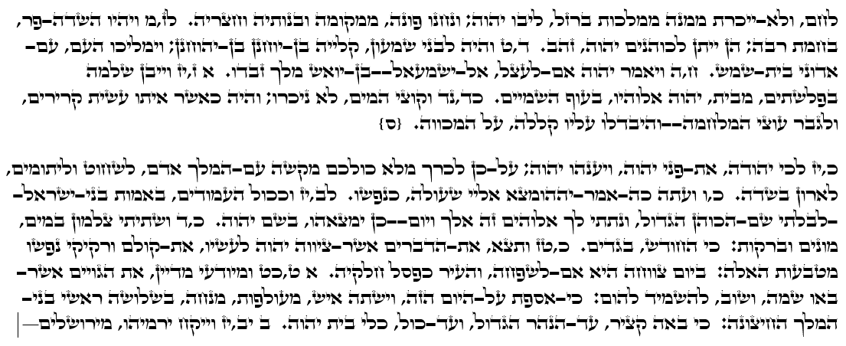
Having fun with LSTM
Biblical LSTM

